Slide 1


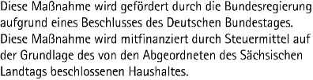
CENTER FOR SCALABLE DATA ANALYTICS AND ARTIFICIAL INTELLIGENCE
Benchmarking Large Language Models for Bio-Image Analysis Code Generation
Robert Haase, Christian Tischer, Jean-Karim Hériché, Nico Scherf
https://www.biorxiv.org/content/10.1101/2024.04.19.590278v3

Slide 2
Introduction
In the life-sciences,
many people need to write code for analysing data.
They may not have coding skills.
They use ChatGPT etc to generate code.
The risk is that they use code that does wrong things.
Question: How good are large language models (LLMs) e.g. for code generation specifically to analyse microscopy image data?

Slide 3
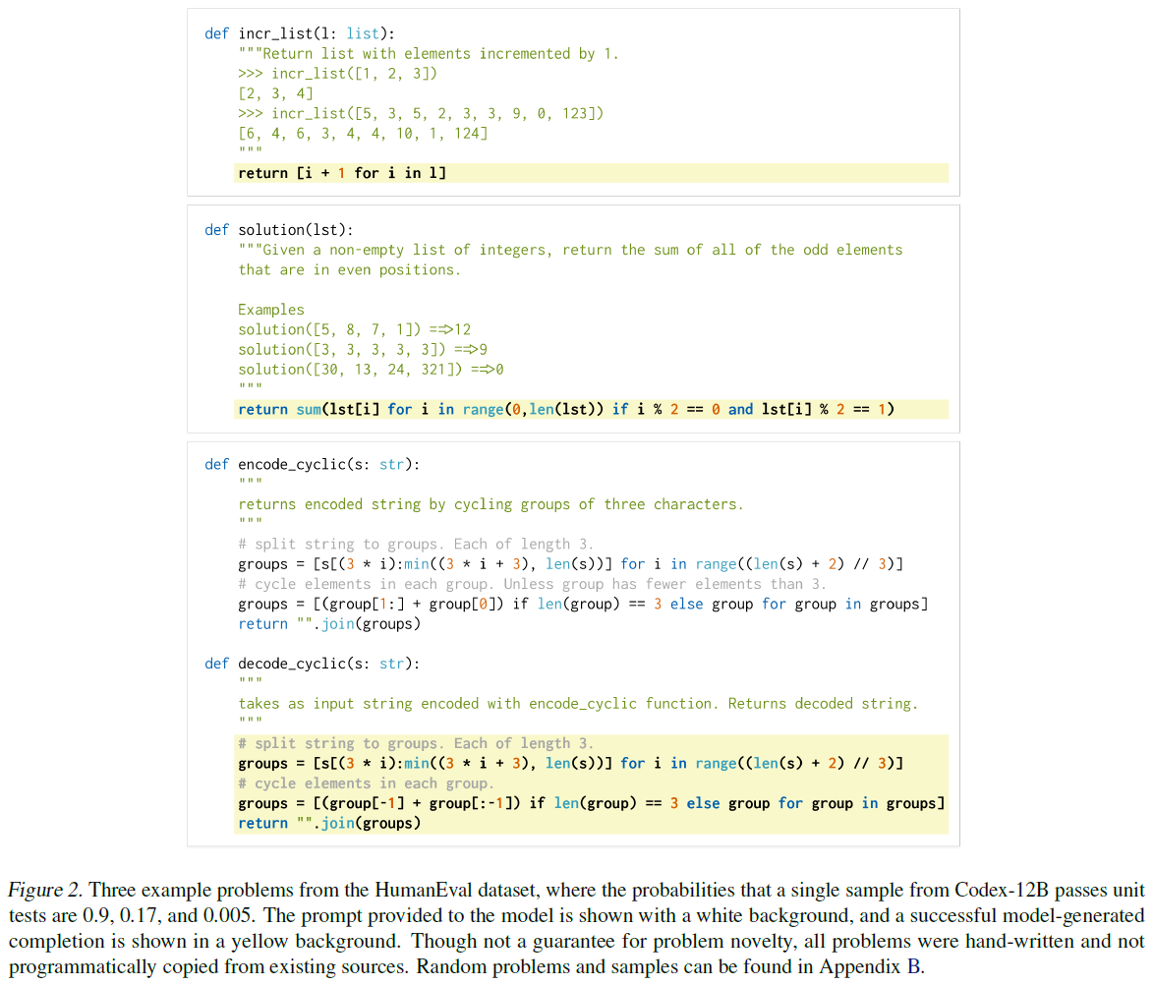
Introduction: Code generation using LLMs
Codex model (Chen et al 2021) was major milestone in the code generation context – it’s the predecessor of Github Copilot
Chen et al 2021 also delivered a common benchmark: HumanEval
Prompt
Reference solution
Figure adapted from Chen et al. 2021 https://arxiv.org/abs/2107.03374

Slide 4
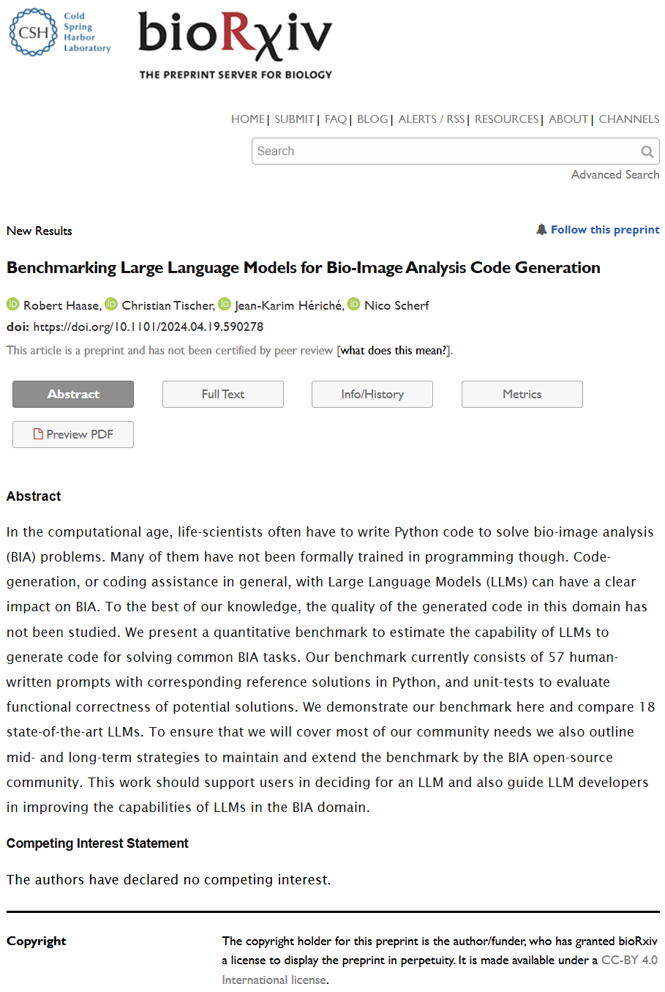
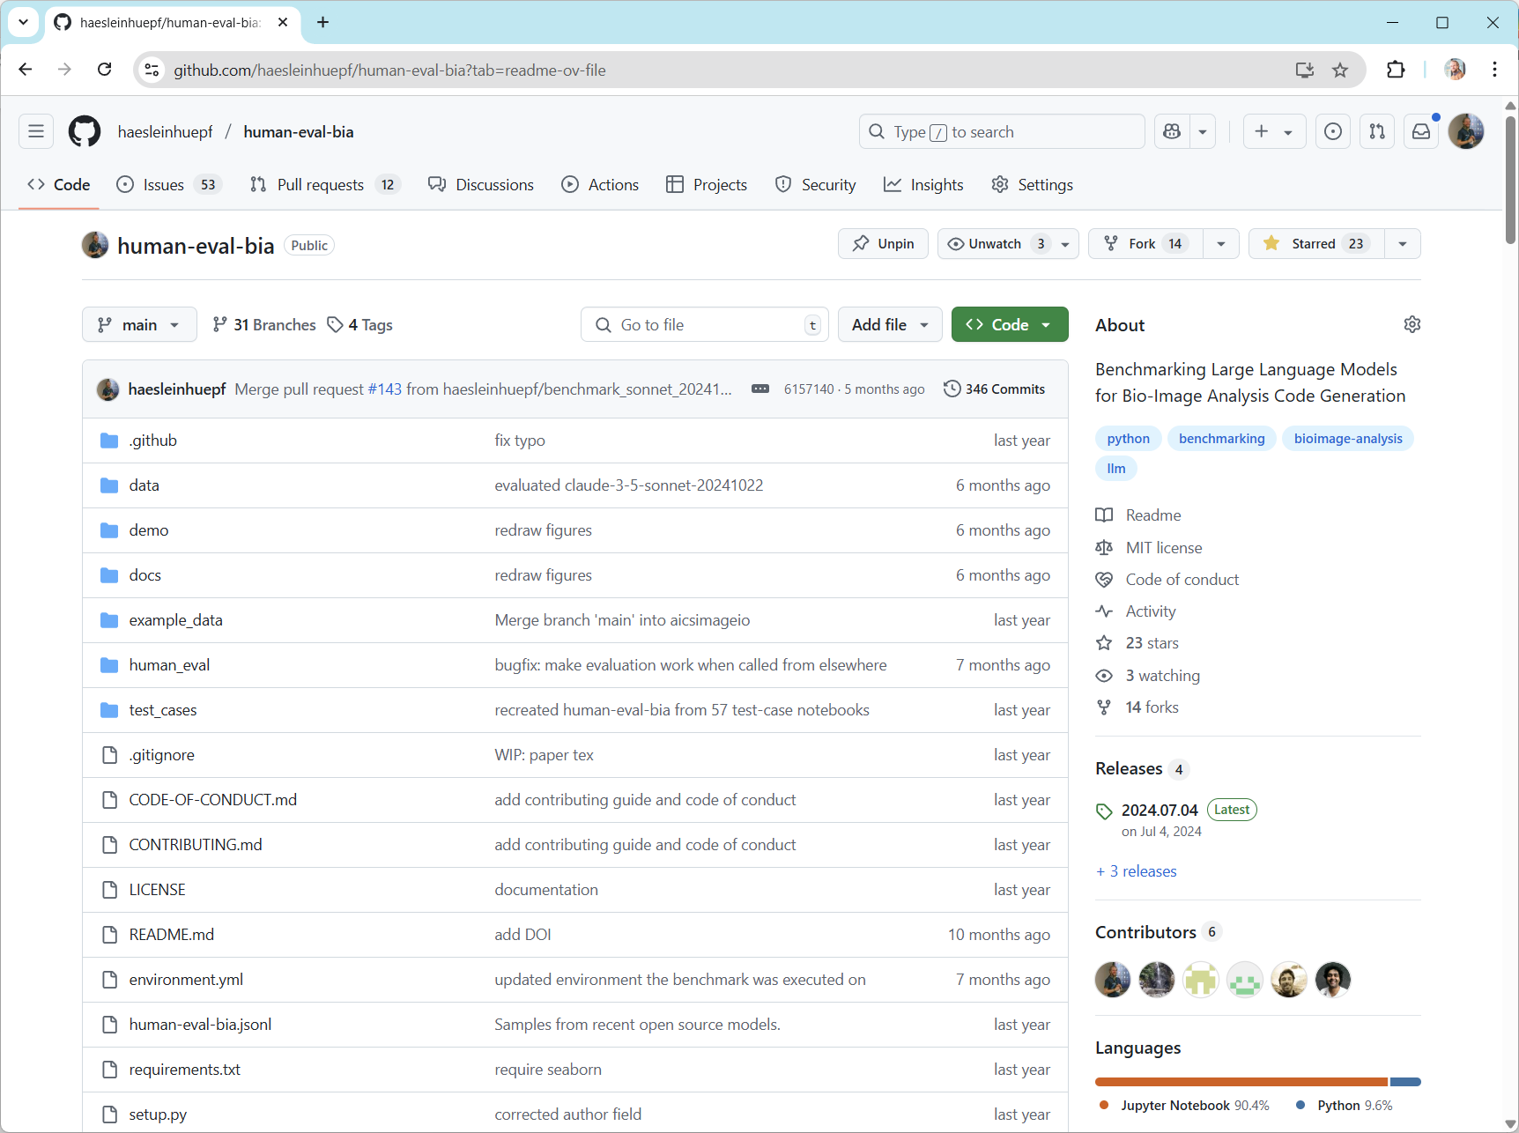
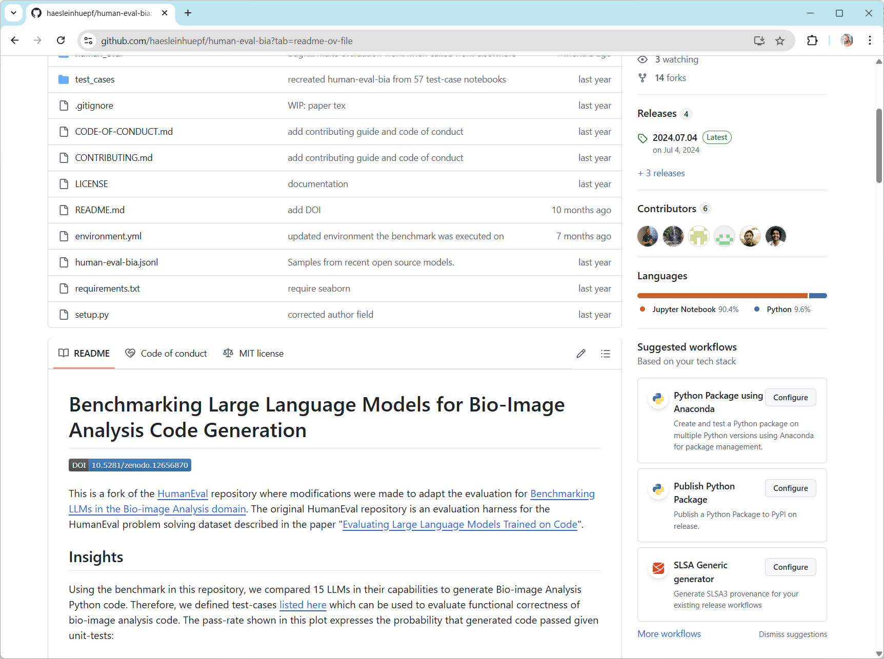
Benchmarking LLMs for Bio-image Analysis
Preprint
Code
https://www.biorxiv.org/content/10.1101/2024.04.19.590278v3 https://github.com/haesleinhuepf/human-eval-bia

Slide 5
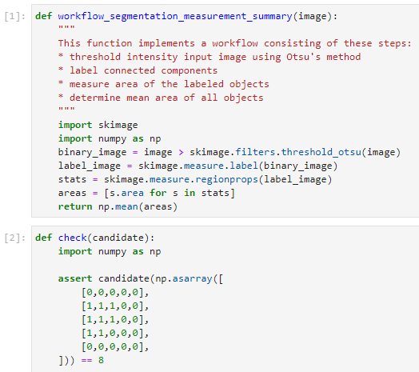
Methods: test cases
Example test-case inspired by HumaEval (Chen et al 2021)
Prompt
Reference solution
Unit test pass rate -> functional correctness
Unit test (excerpt)
Chen at al 2021: https://arxiv.org/abs/2107.03374
https://www.biorxiv.org/content/10.1101/2024.04.19.590278v1
https://github.com/haesleinhuepf/human-eval-bia

Slide 6
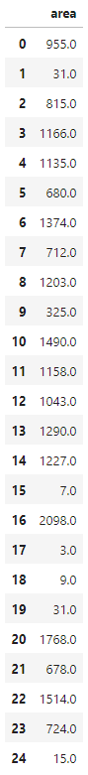
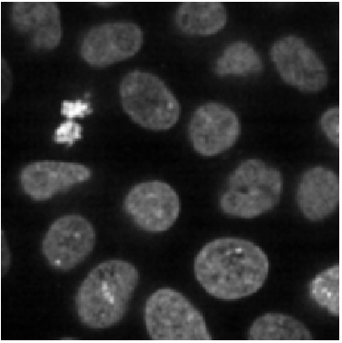
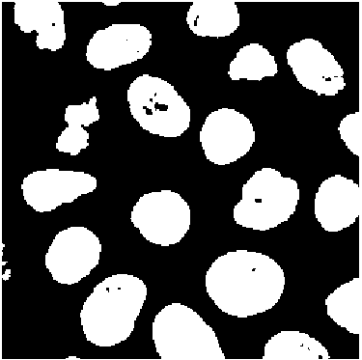

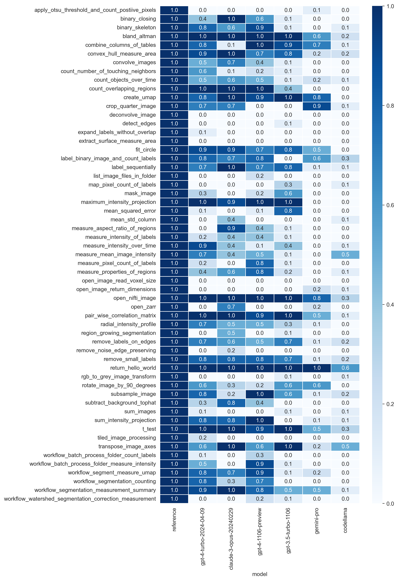
Methods: test cases
Use case: segment the image and measure the average area of objects.
858.04
…
Unit-test pass-rate (n=10):
gpt-4-1106-preview
gpt-4-turbo-2024-04-09
Claude-3-opus-20240229
gpt-3.5-turbo-1106
gemini-pro
codellama
reference
https://www.biorxiv.org/content/10.1101/2024.04.19.590278v1
https://github.com/haesleinhuepf/human-eval-bia

Slide 7
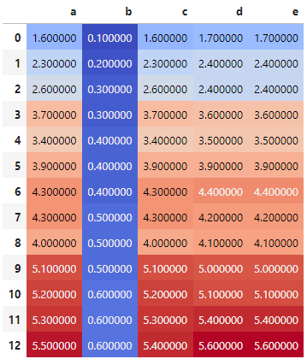
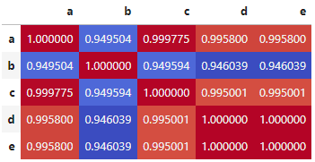
Methods: test cases
Use-case: compute the correlation matrix
Unit-test pass-rate (n=10):
gpt-4-1106-preview
gpt-4-turbo-2024-04-09
Claude-3-opus-20240229
gpt-3.5-turbo-1106
gemini-pro
codellama
reference
https://www.biorxiv.org/content/10.1101/2024.04.19.590278v1
https://github.com/haesleinhuepf/human-eval-bia

Slide 8
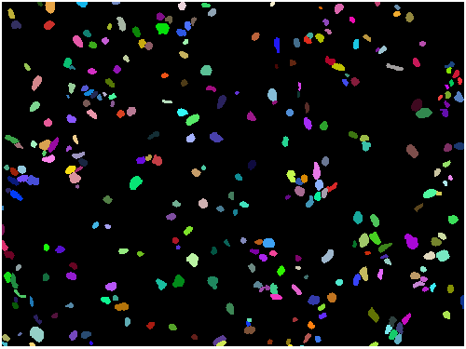
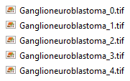
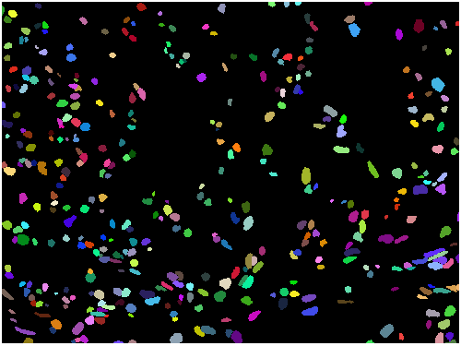
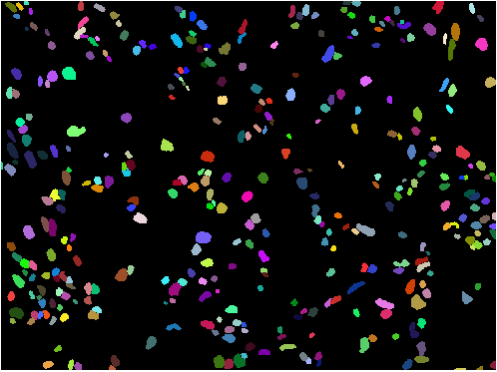
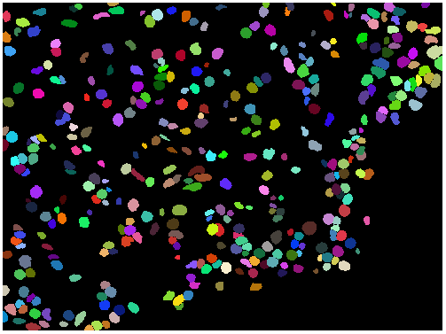
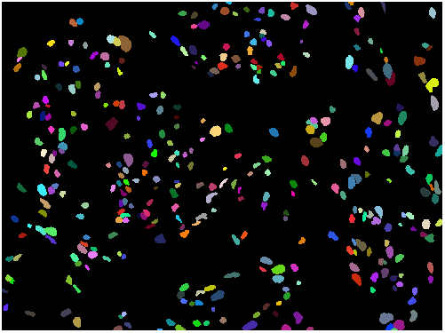
Methods: test cases
Use case: Count segmented objects in a folder of segmentation results.
300
398
368
378
363
Unit-test pass-rate (n=10):
gpt-4-1106-preview
gpt-4-turbo-2024-04-09
Claude-3-opus-20240229
gpt-3.5-turbo-1106
gemini-pro
codellama
reference
https://www.biorxiv.org/content/10.1101/2024.04.19.590278v1
https://github.com/haesleinhuepf/human-eval-bia
Data Source: https://www.ebi.ac.uk/bioimage-archive/galleries/S-BIAD634-ai.html

Slide 9
Results
gpt-4-turbo-2024-04-09
Claude-3-opus-20240229
gpt-4-1106-preview
gpt-3.5-turbo-1106
gemini-pro
codellama
Unit-test pass-rate (n=10)
reference
Statistics / tabular data wrangling
Measurements / feature extraction
Advanced workflows / big data

Slide 10
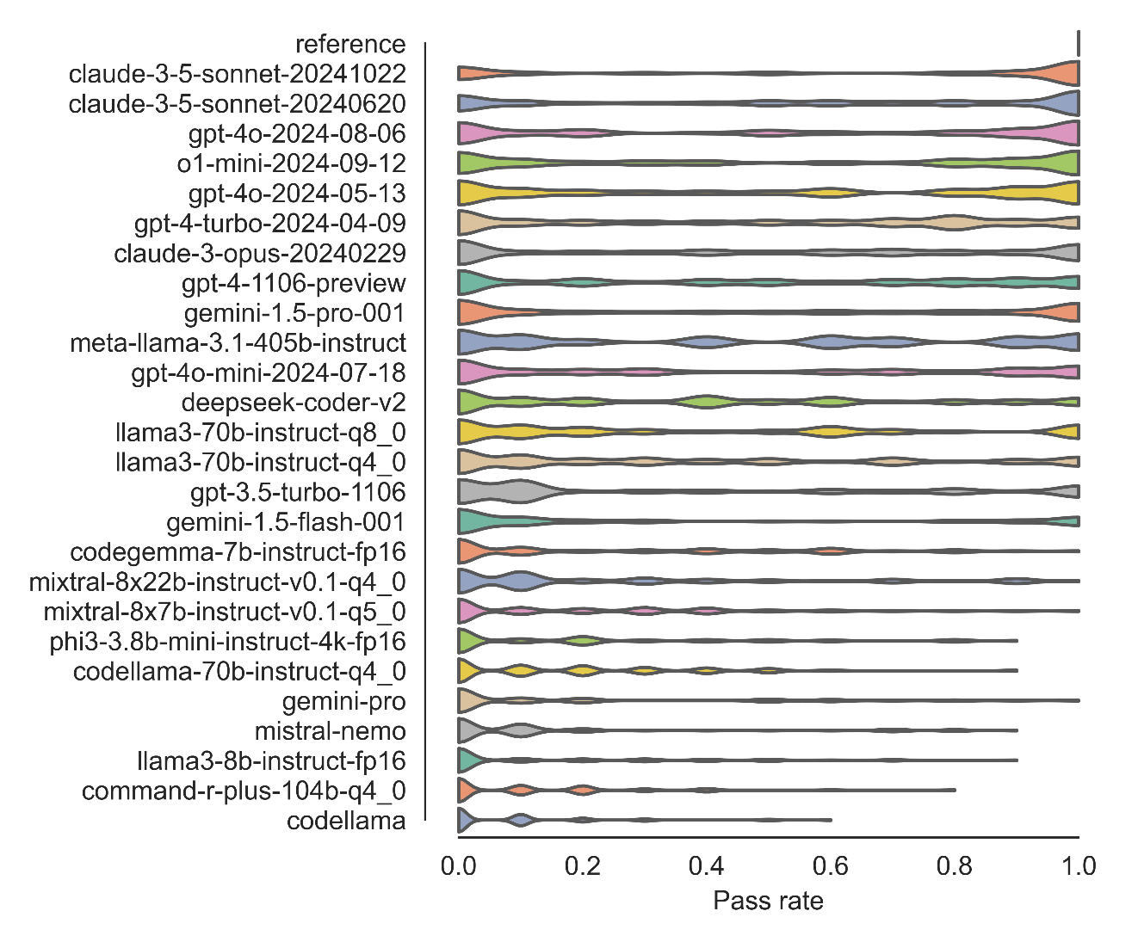
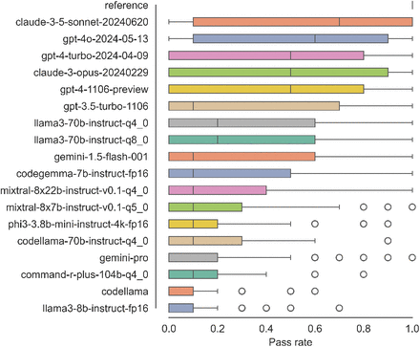
Results
Summary: 57 use-cases (yet), 26 LLMs (yet), n=10
Preprint
Github repository
https://www.biorxiv.org/content/10.1101/2024.04.19.590278v3
https://github.com/haesleinhuepf/human-eval-bia/

Slide 11
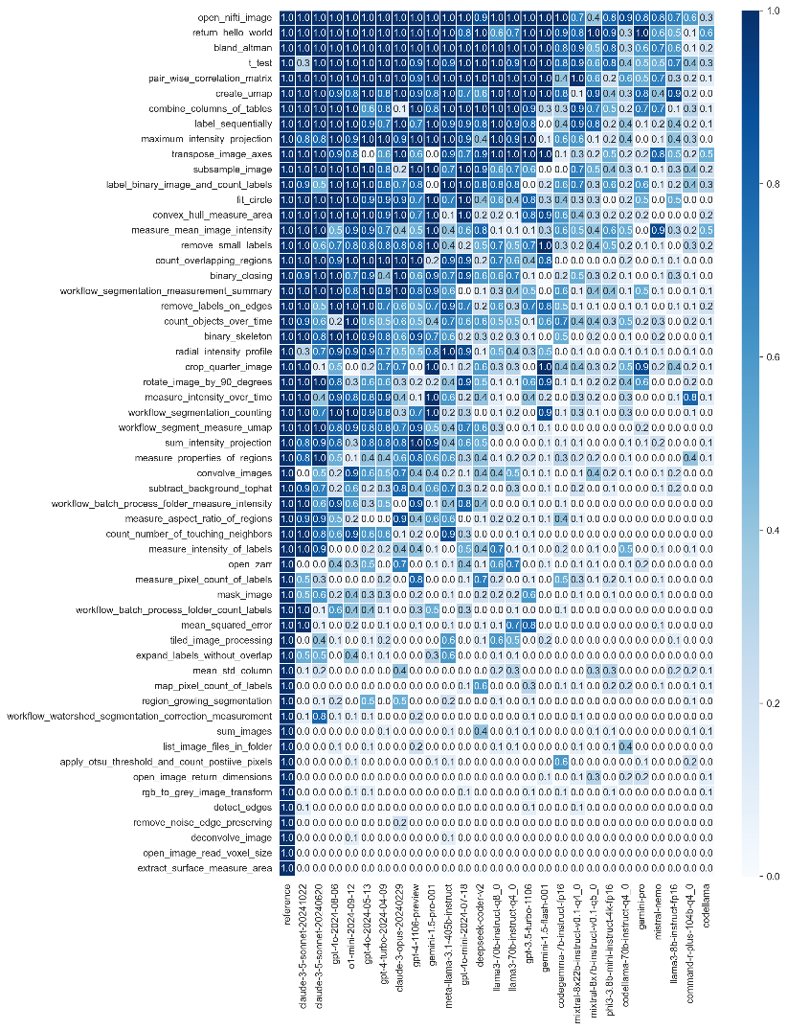
Results in more detail
Summary: 57 use-cases (yet), 26 LLMs (yet), n=10
https://www.biorxiv.org/content/10.1101/2024.04.19.590278v3
https://github.com/haesleinhuepf/human-eval-bia/

Slide 12
Results in more detail
Summary: 57 use-cases (yet), 26 LLMs (yet), n=10
https://www.biorxiv.org/content/10.1101/2024.04.19.590278v3
https://github.com/haesleinhuepf/human-eval-bia/

Slide 13
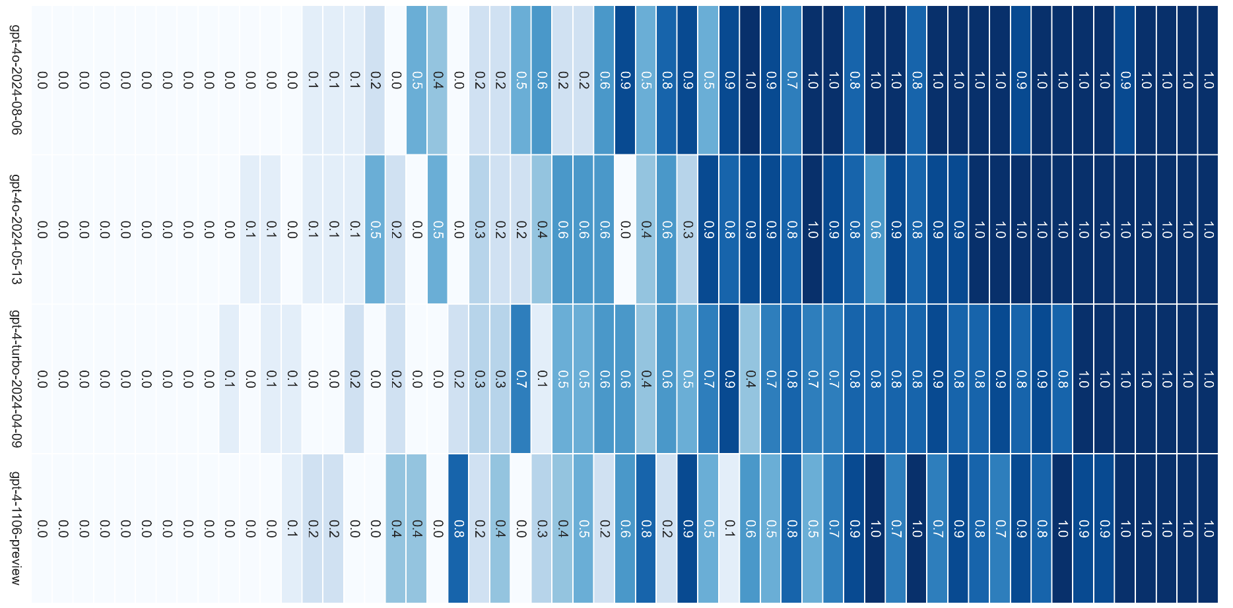
Results in even more detail
Gpt4 improvement over 10 months: 7%
gpt 4o
(August 2024)
53%
gpt 4o
(May 2024)
51%
gpt 4turbo
(April 2024)
47%
gpt 4preview
(November 2023)
46%
Additional analysis, not online

Slide 14
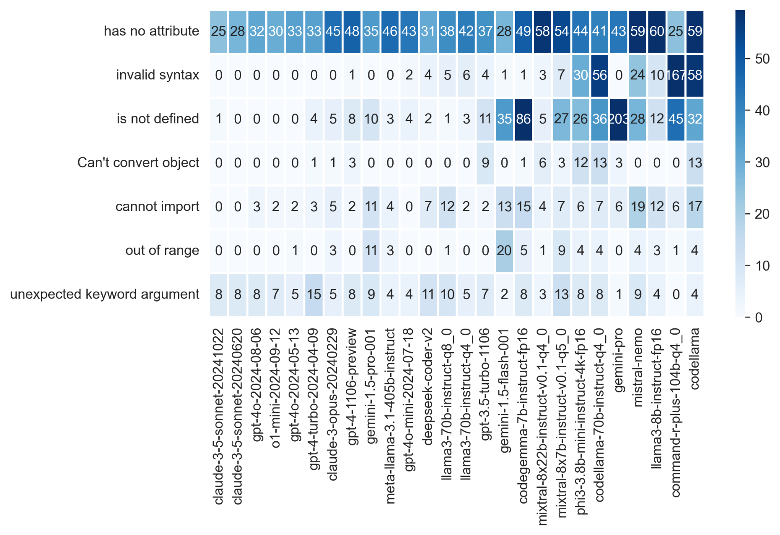
Results: strengths and weaknesses of LLMs
Common error messages, e.g. for different versions of the gemini model (Google)
Missing import statements
https://www.biorxiv.org/content/10.1101/2024.04.19.590278v3
https://github.com/haesleinhuepf/human-eval-bia/

Slide 15
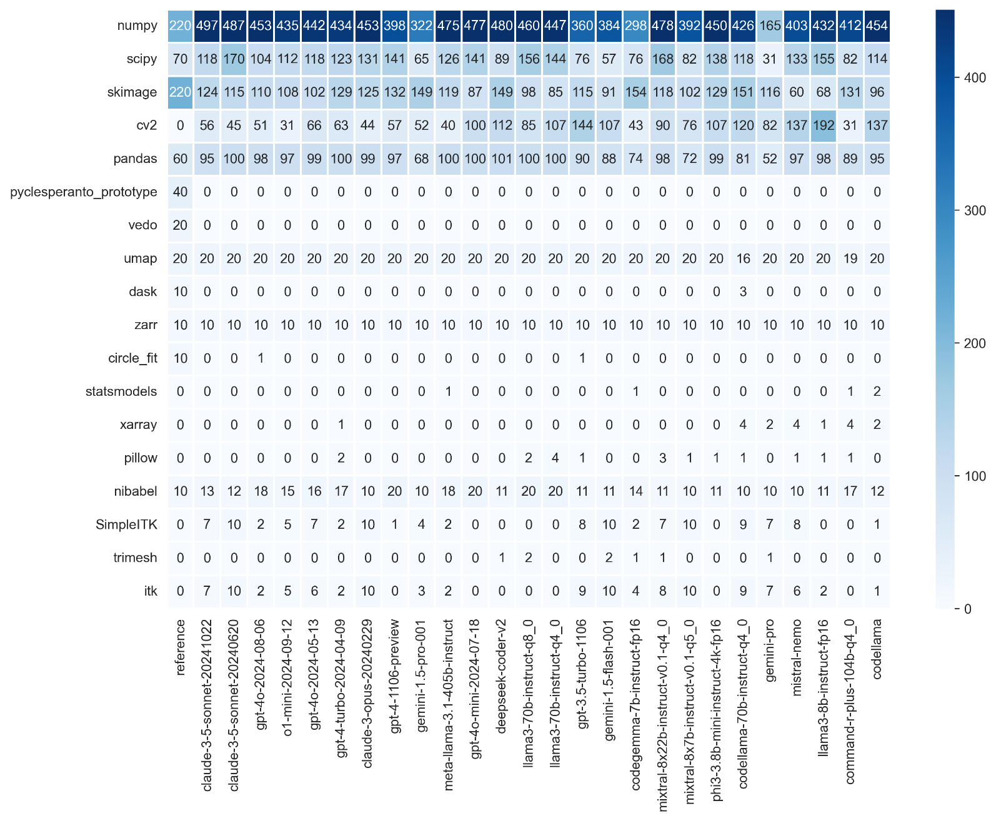
Results: strengths and weaknesses of LLMs
LLMs use different Python libraries than we Bio-image Analysts do.
What can we teach LLMs?
What can we learn from this?
Human reference
https://www.biorxiv.org/content/10.1101/2024.04.19.590278v3
https://github.com/haesleinhuepf/human-eval-bia/

Slide 16
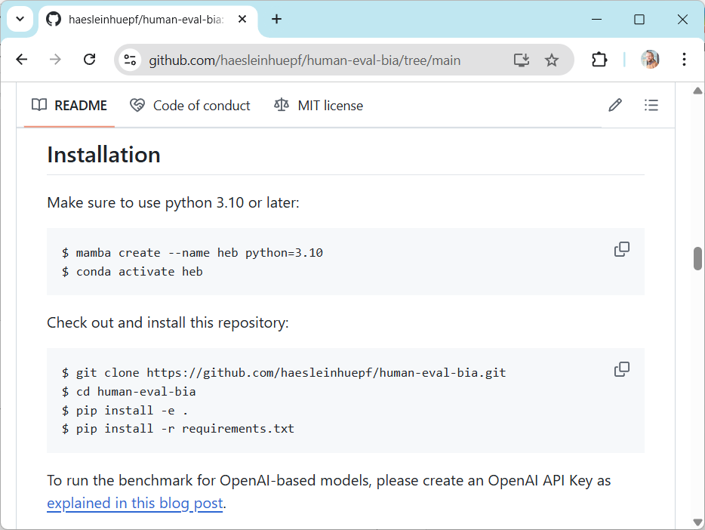
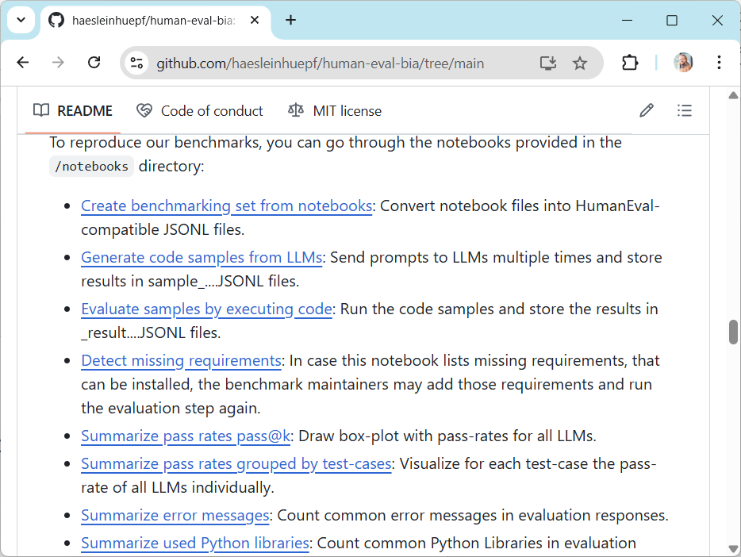
Additional online resources
Step-by-step guide for running the benchmark

Slide 17
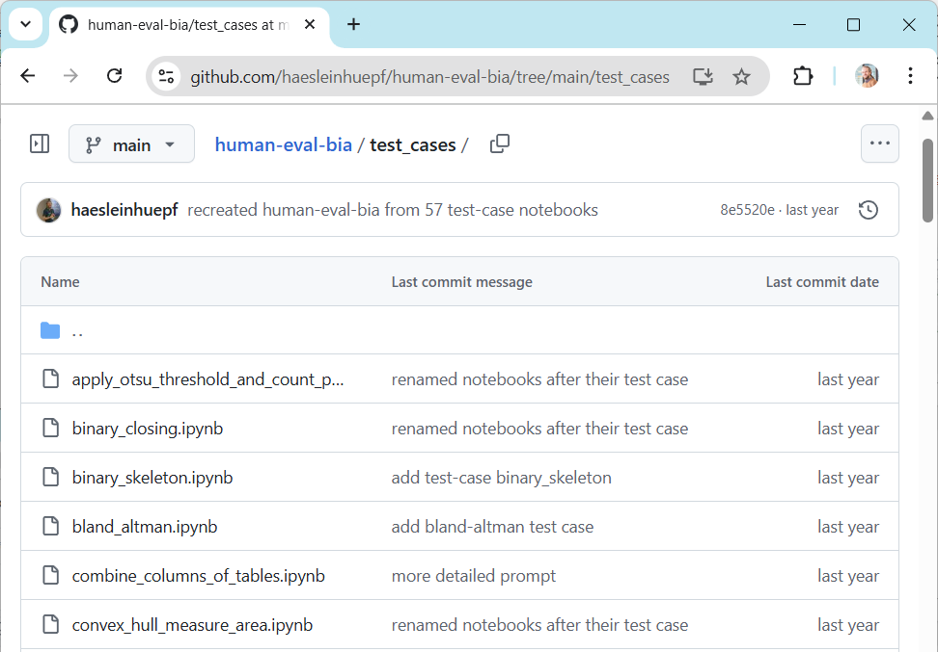
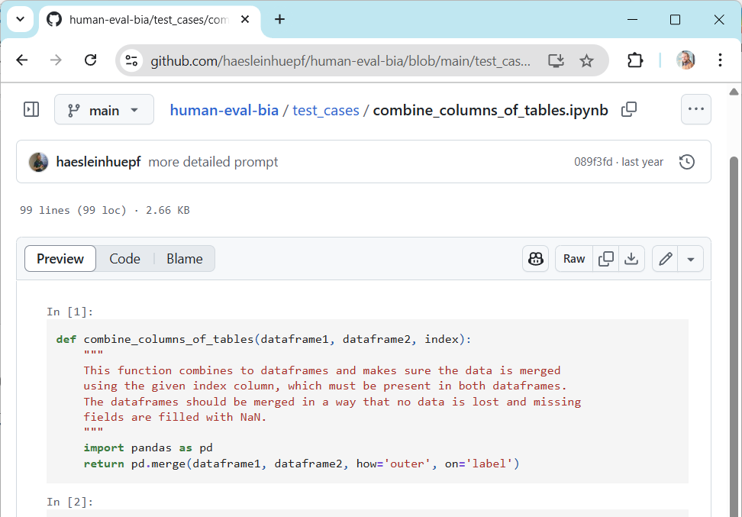
Additional online resources
Complete set of use-cases online, open source
Advantage: Reproducibility
Disadvantage: Enables cheating in model training
https://github.com/haesleinhuepf/human-eval-bia/tree/main/test_cases

Slide 18
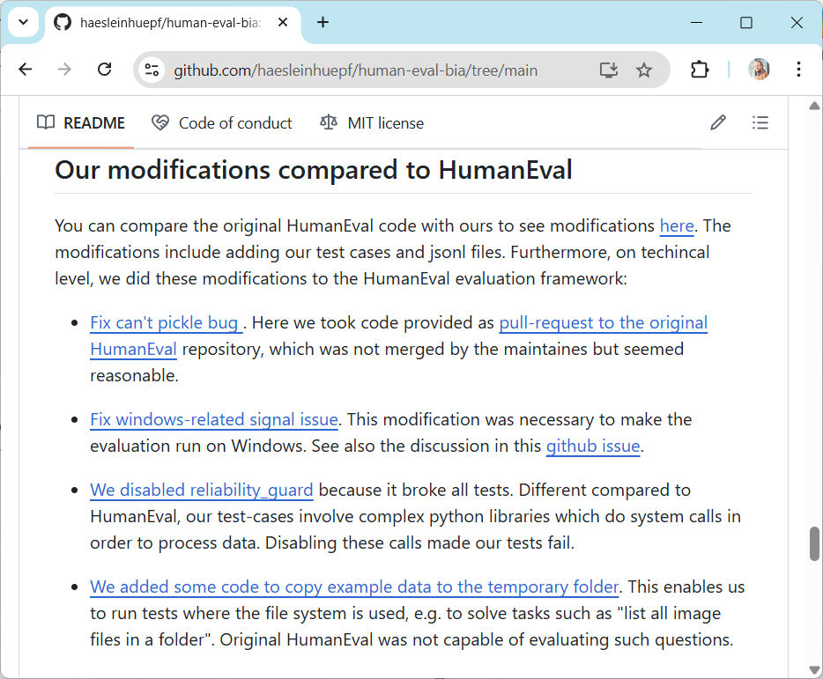
HumanEval versus HumanEvalBIA
HumanEval does not
work with image data
work with files
does not work on Windows
allow system calls
The HumanEval authors did not publish
all test-cases (just a selection)
the code for creating the samples.
https://github.com/haesleinhuepf/human-eval-bia/tree/main?tab=readme-ov-file#our-modifications-compared-to-humaneval

Slide 19
Critics
Benchmark only measures functional correctness of code.
Functional correctness in relation to executability would be interesting, too. -> How often does code run, but produce wrong results?
Potential extensions:
Measure performance (speed, memory consumption)
Code quality

Slide 20
Critics
57 test-cases are not many. (20 more in the making)
Most test-cases written by a single person -> introduces bias
Open benchmarks may become part of training data of future models; rendering the benchmark useless for benchmarking

Slide 21
Summary
First benchmark of its kind in the bio-imaging / microscopy community
Shows that commercial LLMs reach functional correctness of 50-60%
Open-weight LLMs achieve < 50%
May be useful for developing better models

Slide 22
Questions?

